Slide 1
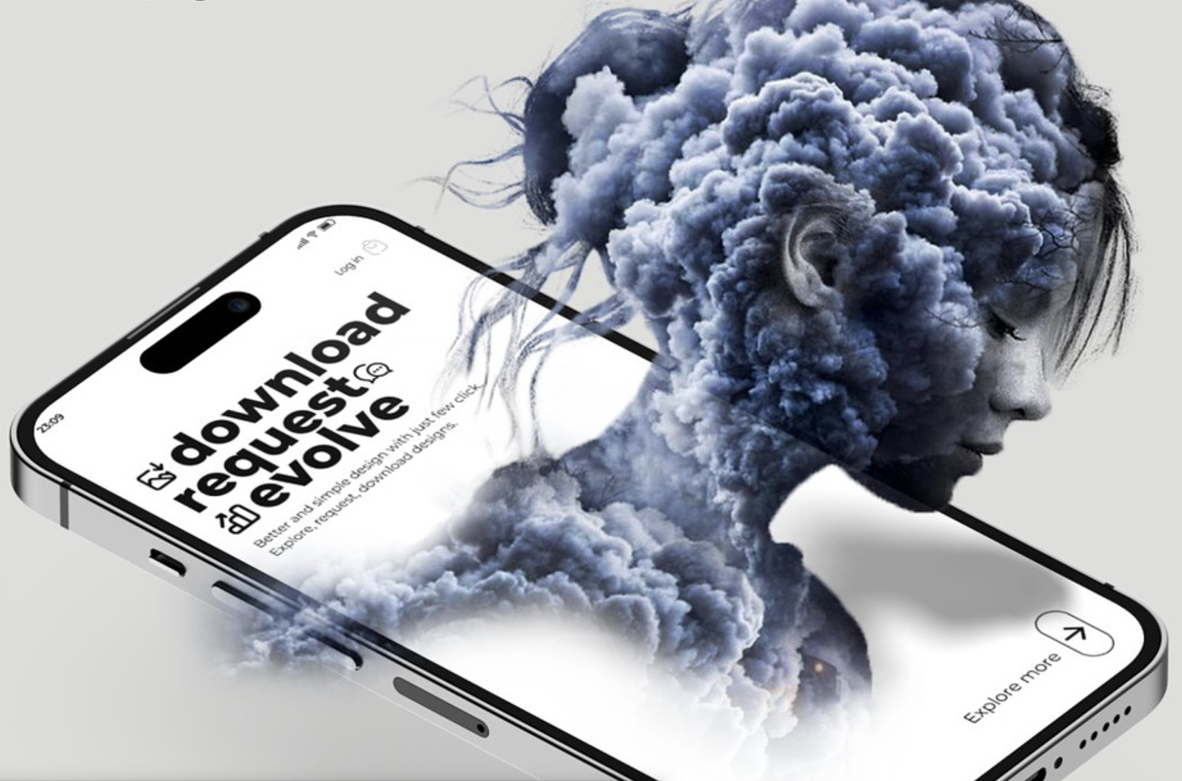
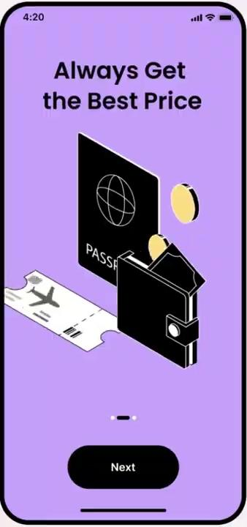

Slide 2
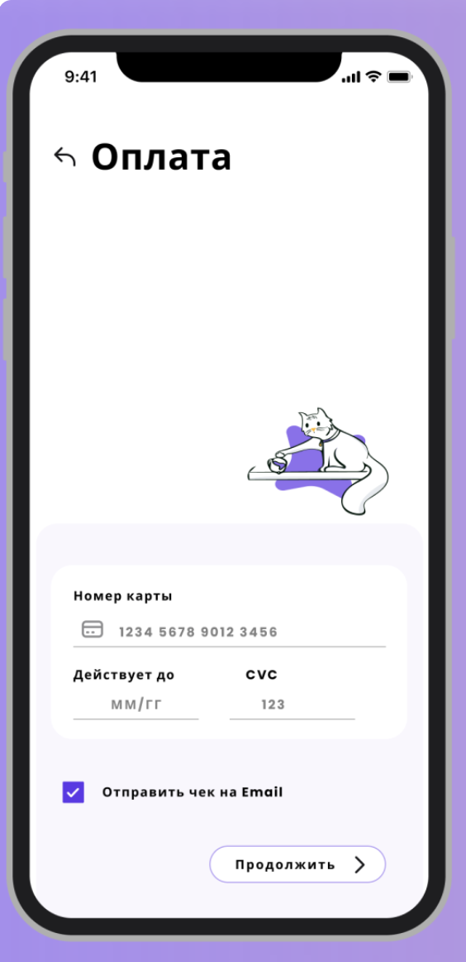
Application of Animations in iOS Apps for engaging UI/UX Experience 👩‍💻

Slide 3

Why do we need to incorporate animations? Do they impact in user acquisition or engagement?
Animations create major impact if we consider :
User Acquisition
User Engagement
Much improved User Experience
User Retention
Brand Identity
Realism and Interactivity

Slide 4

SpriteKit
Types of Animations Offered by iOS
Lottie
CABasicAnimation CAKeyframeAnimation
CATransition CASpringAnimation
UIViewPropertyAnimator
UIViewController
Animated Transitioning
Core Animation
UIView Animations
UIKit Dynamics

Slide 5
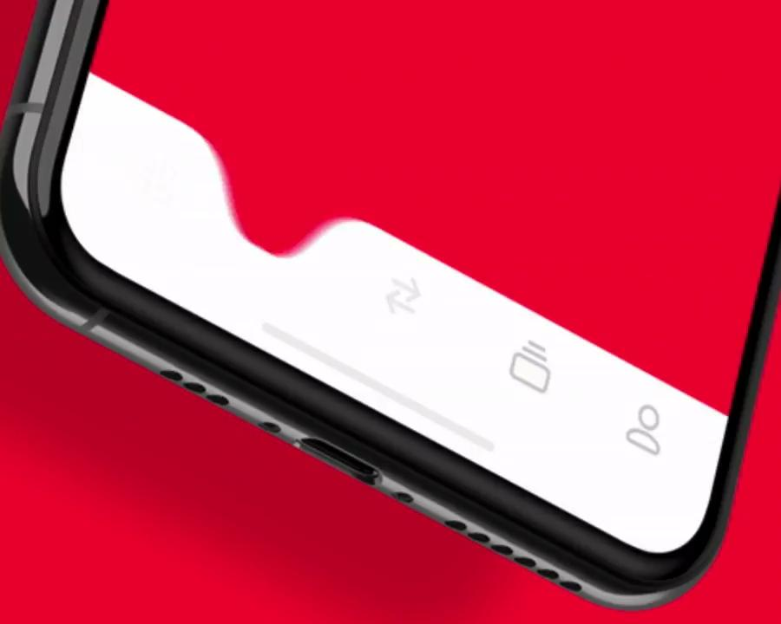
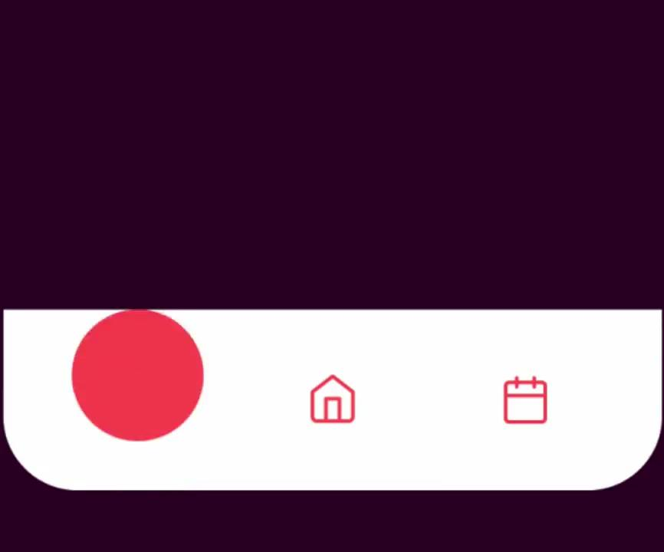
Intuitive UI, Anything that a user would feel easiest interacting with - Smooth Transitioning

Slide 6
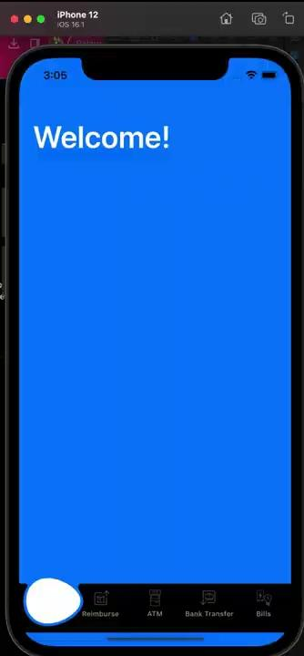
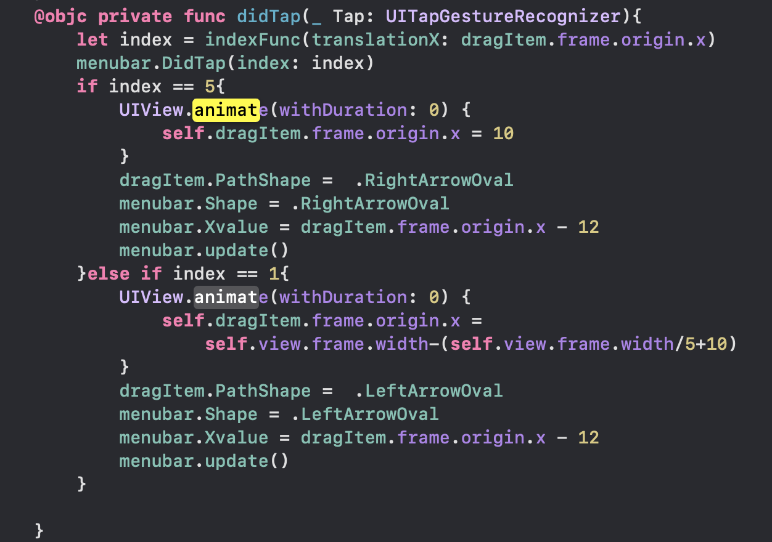
UIView.animate

Slide 7
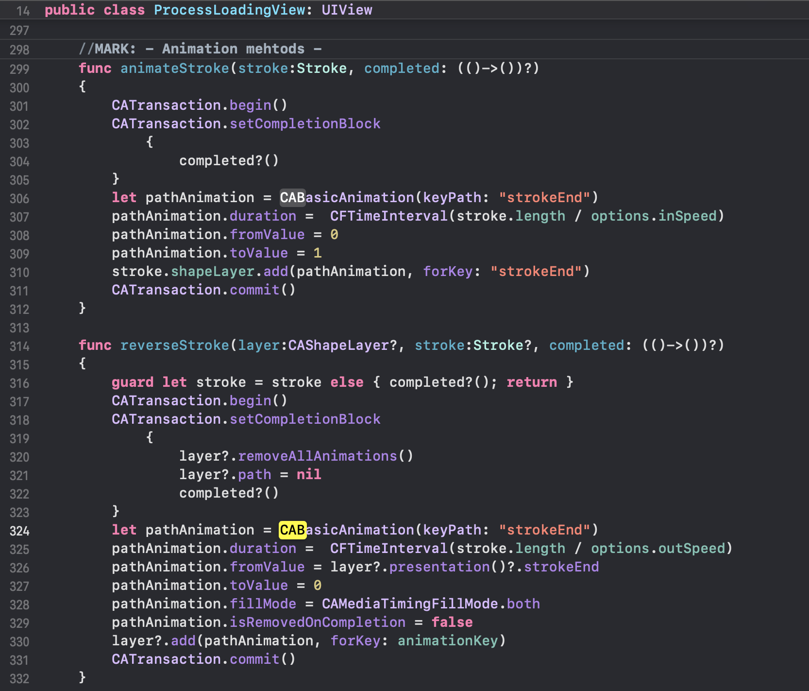

CABasicAnimation

Slide 8
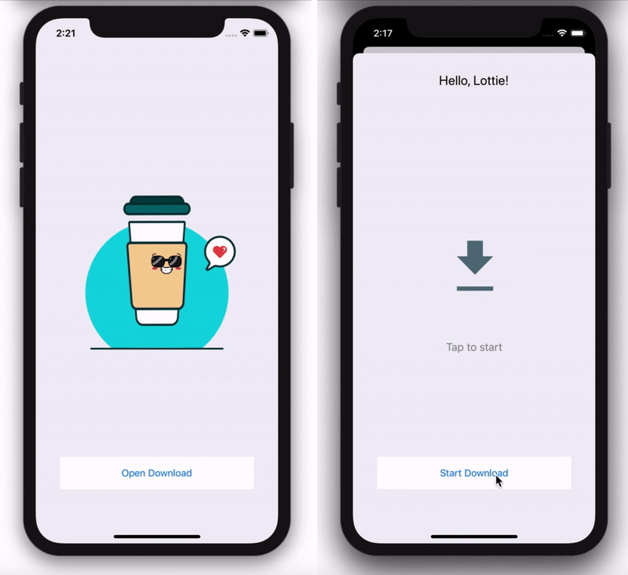
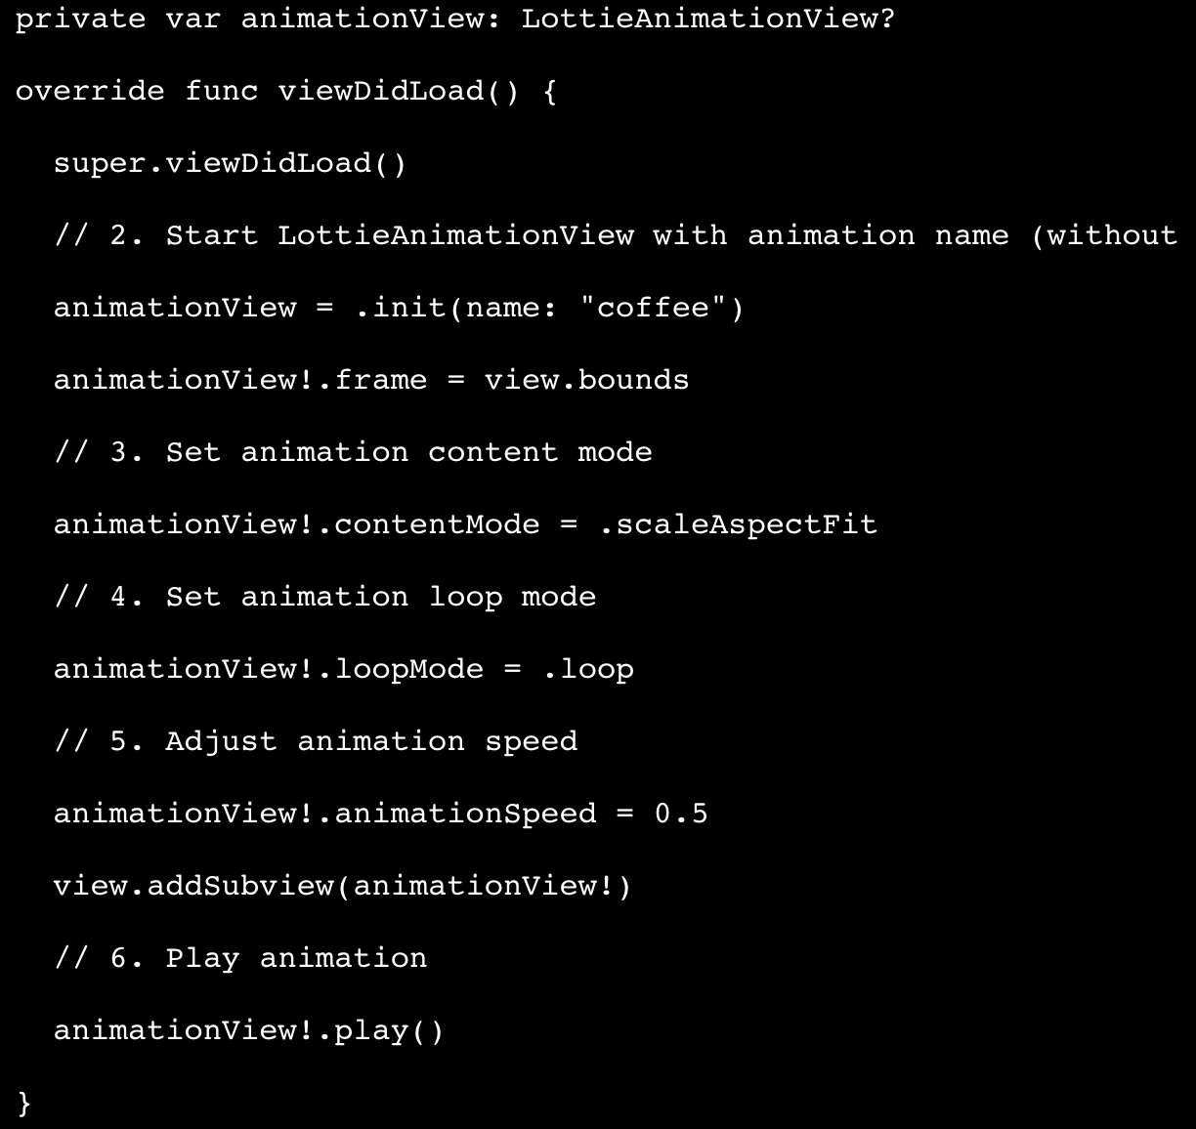
Lottie

